Slide 1
Competitive Programming
10 Feb. 2023
Andrei Novikov

Slide 2
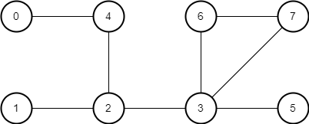
Homework Revise
UVa 10765 – Doves and Bombs – Link to the Task
What to bomb?

Slide 3
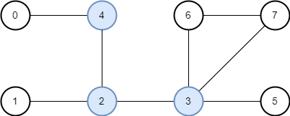
Homework Revise
UVa 10765 – Doves and Bombs – Link to the Task
Transform the question
Where are the articulation points on the graph?

Slide 4
Homework Revise
UVa 10765 – Doves and Bombs – Link to the Task
What is ‘pigeon value’ here?

Slide 5
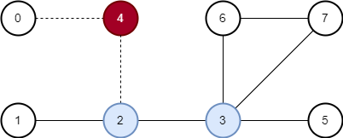


Homework Revise
UVa 10765 – Doves and Bombs – Link to the Task
Two pigeons are needed if 4 is destroyed

Slide 6
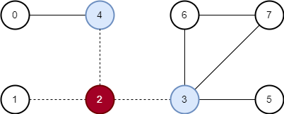



Homework Revise
UVa 10765 – Doves and Bombs – Link to the Task
Three pigeons are needed if 4 is destroyed

Slide 7
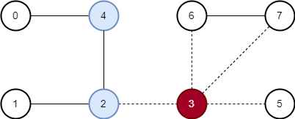



Homework Revise
UVa 10765 – Doves and Bombs – Link to the Task
Three pigeons are needed if 3 is destroyed

Slide 8
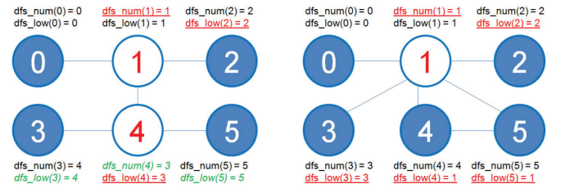
Homework Revise
UVa 10765 – Doves and Bombs – Link to the Task
DFS low value helps to identify subgraphs around the articulation point.
Reminder: Low Value is minimum node ID value reachable from spanning sub-tree.

Slide 9
Homework Revise
UVa 10765 – Doves and Bombs – Link to the Task
DFSLowLink[v] >= DFSId[u] – articulation point
Essential it mean that there is no edge from v that allow to reach w with smaller ID than u

Slide 10
Homework Revise
UVa 10765 – Doves and Bombs – Link to the Task
Every time when we detect articulation node, we need to increment the counter of subgraphs

Slide 11
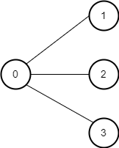
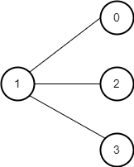
Homework Revise
UVa 10765 – Doves and Bombs – Link to the Task
Solution – Link
The solution works… But is there bug in the verification system?
The verification is based on articulation search algorithm that could not count subgraphs for the initial node.
0 2
1 1
2 1
3 1
1 3
1 1
2 1
3 1

Slide 12

Homework Revise
UVa 10765 – Doves and Bombs – Link to the Task
Solution – Link
The proper way to solve the problem, but not acceptable
Find articulation points
For each point find subgraphs using low link
In this case, the problem on the prev. slide is solved properly

Slide 13

Practice – Challenge #1
Read the task (link) and think about possible solution.

Slide 14
Practice – Challenge #2
Read the task (link) and think about possible solution.

Slide 15




Where to Practice
LeetCode [link]
HackerRank [link]
Kattis [link]
TopCoder [link]
Other Resources

